Slide 1
Topic Modelling

Slide 2
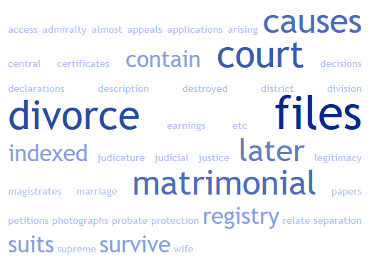
Word Cloud – Supreme Court Divorce records
Source data - http://discovery.nationalarchives.gov.uk/details/r/C9685

Slide 3
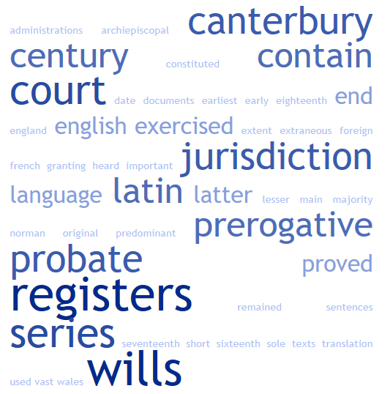
Word Cloud – Prerogative Court of Cantebury
Source data - http://discovery.nationalarchives.gov.uk/details/r/C12122

Slide 4
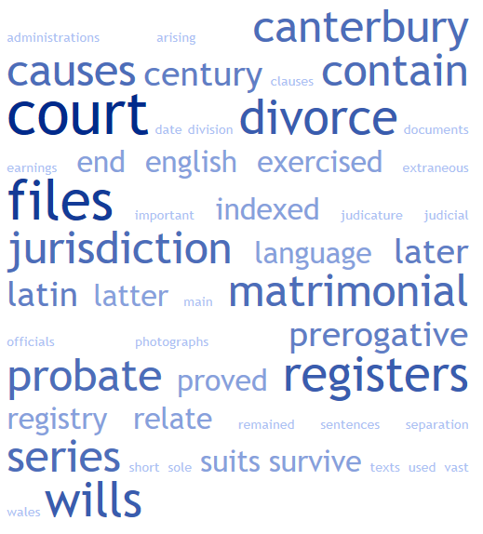
Word Cloud - Combined

Slide 5
Grouping documents by subject

Slide 6
How topic modelling views the world
pressure
century
pressure
measure
player
century
past
Science
ball
Sport
History

Slide 7
Reverse engineer the process
Find two topics, two words per topic
shot
blah
ball
last
20th
century
19th
century
century
great
shot
monarch
ball
monarch
monarch
score
century
shot
play
score
blah
blah
score
rules
blah
past
rule
ball
blah
blah
blah
ball
past
century
past
blah
play
rule

Slide 8
Topic modelling in action
Randomly assign topics
shot
blah
ball
last
20th
century
19th
century
century
great
shot
monarch
ball
monarch
monarch
score
century
shot
play
score
blah
blah
score
rules
blah
past
rule
ball
blah
blah
blah
ball
past
century
past
blah
play
rule
Pick a word
How prevalent is that word across topics?
How prevalent are topics in the document?

Slide 9
Topic modelling in action
Pick a word
For each topic:
How prevalent is that word across topic?
shot
blah
ball
last
20th
century
19th
century
century
great
shot
monarch
ball
monarch
monarch
score
century
shot
play
score
blah
blah
score
rules
blah
past
rule
ball
shot
blah
blah
ball
past
century
past
blah
play
rule

Slide 10
Topic modelling in action
How prevalent is the topic in the document?
shot
blah
ball
last
20th
century
19th
century
century
great
shot
monarch
ball
monarch
monarch
score
century
shot
play
score
blah
blah
score
rules
blah
past
rule
ball
shot
blah
blah
ball
past
century
past
blah
play
rule

Slide 11
Topic modelling in action
Pick a word
shot
blah
ball
last
20th
century
19th
century
century
great
shot
monarch
ball
monarch
monarch
score
century
shot
play
score
blah
blah
score
rules
blah
past
rule
ball
shot
blah
blah
ball
past
century
past
blah
play
rule

Slide 12
Output of a topic model
A:
ball
score
B:
century
monarch

Slide 13
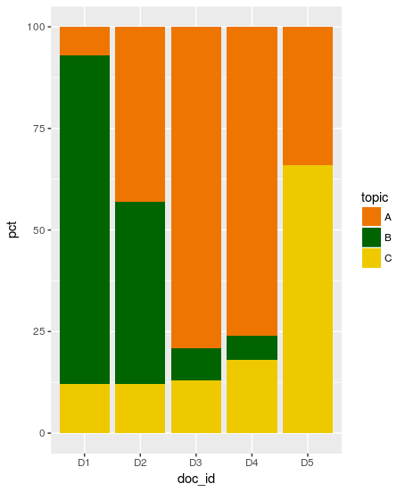
Document breakdown

Slide 14
Mallet output – top words per topic
0 1 hand long night room looked
1 1 thought good life man felt
2 1 miss mrs thing emma harriet
3 1 madame time monsieur english white
4 1 mrs time elinor elizabeth day
0 1 night room don't sir life rochester heard heart asked voice
1 1 mrs miss emma thing elinor dear great marianne good harriet
2 1 elizabeth lady mother felt letter sister man make good feelings
3 1 long time day looked found house made place mind evening
4 1 madame monsieur english thought bretton graham eyes eye knew paul

Slide 15
Topic for each word
5 austen-brontë-split/Austen_Emma0005.txt 94 1034 scramble 1
5 austen-brontë-split/Austen_Emma0005.txt 95 638 education 2
5 austen-brontë-split/Austen_Emma0005.txt 96 88 danger 2
5 austen-brontë-split/Austen_Emma0005.txt 97 333 coming 3
5 austen-brontë-split/Austen_Emma0005.txt 98 425 back 1
5 austen-brontë-split/Austen_Emma0005.txt 99 1035 prodigies 2
5 austen-brontë-split/Austen_Emma0005.txt 100 203 mrs 1
5 austen-brontë-split/Austen_Emma0005.txt 101 1036 goddard's 1
5 austen-brontë-split/Austen_Emma0005.txt 102 1037 school 3
5 austen-brontë-split/Austen_Emma0005.txt 103 1038 high 3

Slide 16
Topics per document
0 austen-brontë-split/Austen_Emma0000.txt 0.0354 0.293 0.352 0.312 0.007
1 austen-brontë-split/Austen_Emma0001.txt 0.031 0.629 0.140 0.196 0.003
2 austen-brontë-split/Austen_Emma0002.txt 0.0085 0.625 0.269 0.088 0.008
3 austen-brontë-split/Austen_Emma0003.txt 0.0317 0.339 0.342 0.273 0.0122
4 austen-brontë-split/Austen_Emma0004.txt 0.0169 0.384 0.363 0.232 0.0024
5 austen-brontë-split/Austen_Emma0005.txt 0.0422 0.335 0.233 0.317 0.071

Slide 17
The Command Line

Slide 18
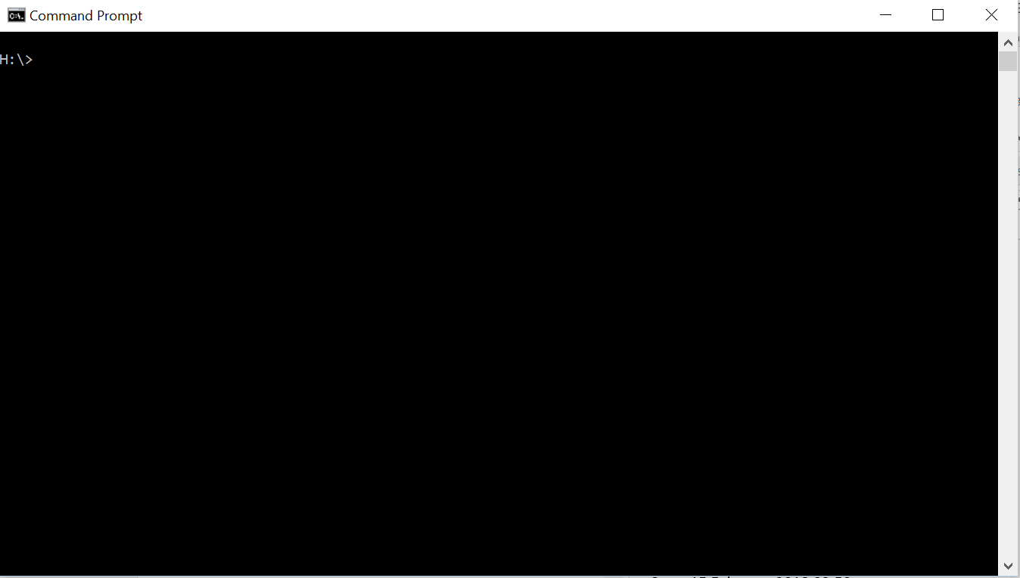
Introduction to the Command Line
There was a time before Windows….

Slide 19
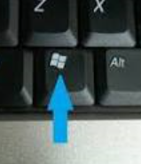
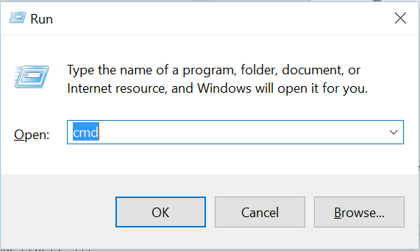
How to open the Command Prompt
Windows
Press Windows Key + R at same time to open Run window.
Type cmd into the search and hit Enter/Return or click OK
The command prompt window should open
https://www.digitalcitizen.life/7-ways-launch-command-prompt-windows-7-windows-8

Slide 20
How to open the Command Prompt
Mac
Mac OS X is built on a version of Unix called Darwin.
Use Finder to go to the Applications Folder
From there go to the Utilities folder
Open the Terminal application
https://www.wikihow.com/Get-to-the-Command-Line-on-a-Mac

Slide 21
How to open the Command Prompt
Linux
You probably already know this
In Ubuntu press Ctrl + Alt + T

Slide 22
Common commands
Windows command | Unix command | Notes
cd | cd | On Windows, cd alone prints the current directory, but on Unix cd alone returns the user to his home directory.
cd | pwd | On Windows, cd alone prints the current directory.
cls | clear | Clear the terminal screen
copy | cp
del | rm
dir | ls | "dir" also works on some versions of Unix.
doskey /h F7 key | history | The Unix history is part of the Bash shell.
edit | vi emacs etc. | edit brings up a simple text editor in Windows. On Unix, the environment variable EDITOR should be set to the user's preferred editor.
exit | exit Control-D | On Unix, pressing the control key and D simultaneously logs the user out of the shell.
help | man | "help" by itself prints all the commands
mkdir | mkdir
more | more less
move | mv
rmdir | rmdir
rmdir /s | rm -r | Windows has a y/n prompt. To get the prompt with Unix, use rm -i. The i means "interactive".
set | env | Set on Windows prints a list of all environment variables. For individual environment variables, set <variable> is the same as echo $<variable> on Unix.
set Path | echo $PATH | Print the value of the environment variable using set in Windows.

Slide 23
Navigating on the command line
Where am I?:
Windows: cd
Linux: pwd
What is here?
Windows: dir
Linux: ls
Go to a folder here: cd <folder name>
Go backwards: cd ..
Go to a specific folder:
Windows: cd c:\<level 1>\<level 2>\ etc.
Linux: cd /<level 1>/<level 2>/ etc.
Handy trick: Use Tab to autocomplete folders

Slide 24
Running Programs
To run a program just type its name
What is its name?
It depends….
If you’re in the folder where it resides then its name is its name
If you’re in a different folder you may need to include its full path
(the folder hierarchy separated by / or \)
If there is an environment variable pointing to that folder then you don’t need to refer to it
That isn’t quite everything….

Slide 25
Programs have parameters
Parameters are either information the program needs, or instructions for how to perform its task
They take two main forms – named and unnamed
For unnamed parameters just type values after the program name
For named parameters put the name of the parameter, often preceded with one or two hyphens, before the value
Examples to follow….

Slide 26
Example 1 – Linux ls command
ls lists the contents of a folder
It is built into the Linux environment so is called without needing to refer to the path

Slide 27
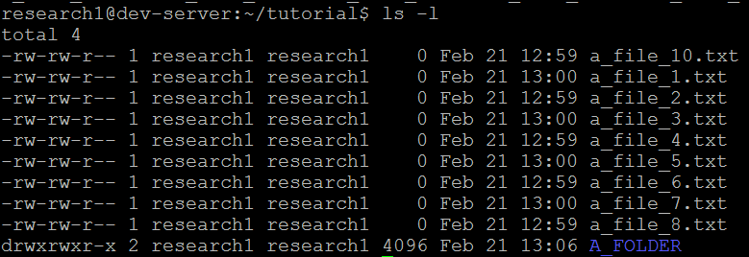

ls on its own
ls with the –l parameter
ls with the –l parameter and a folder name

Slide 28
Example - Mallet
Command = bin/mallet
Mallet function = import-dir
Input file location; named parameter = --input <file path>

